Slide 1
Picture Puzzle
Mohammad Shoaib Khan
Branch: CSE (AI&ML) - A
CRN: 21CSME039
Submitted To: Hari Mohan Dixit

Slide 2

INTRO
“Picture Puzzle” is a sliding puzzle game made with the programming language, C#. The goal of the game is to challenge the players’ problem-solving skills by rearranging tiles to form a complete picture within the given time limit.

Slide 3
Objective
The main objective for making this game was to learn more about game development.
I also got to learn about image manipulation using Inkscape and GIMP softwares.

Slide 4
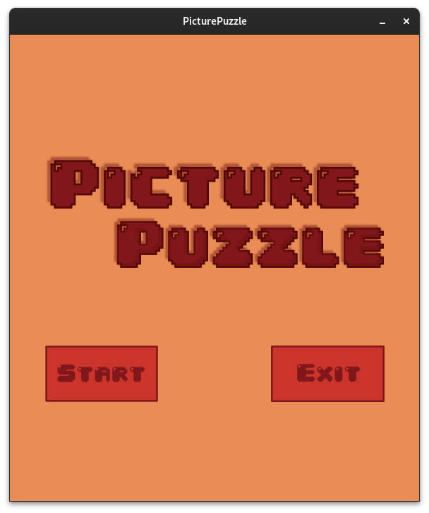
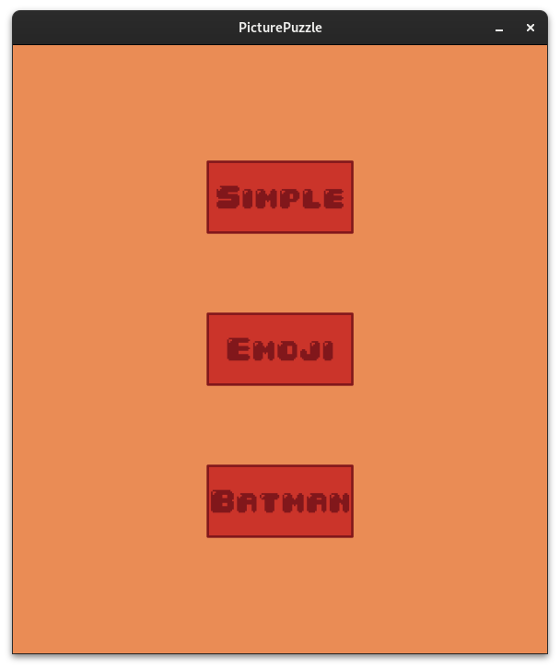
DEMO
1: Title Page
2: Board Selection Page

Slide 5
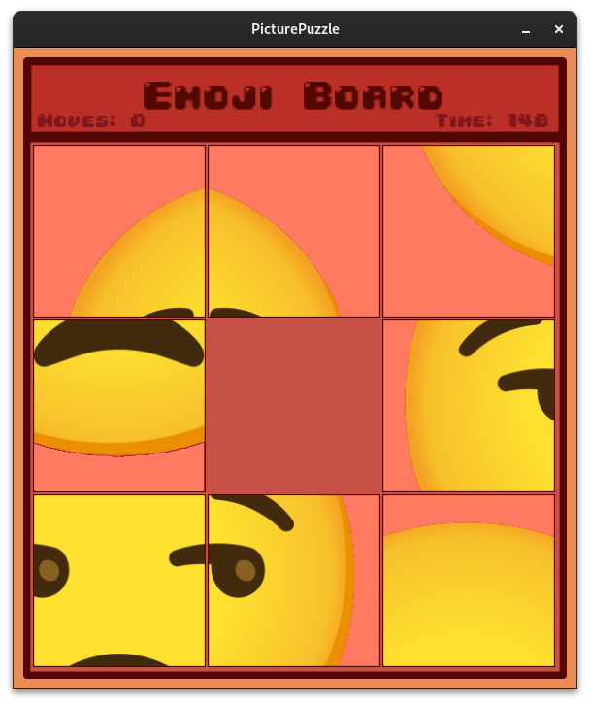
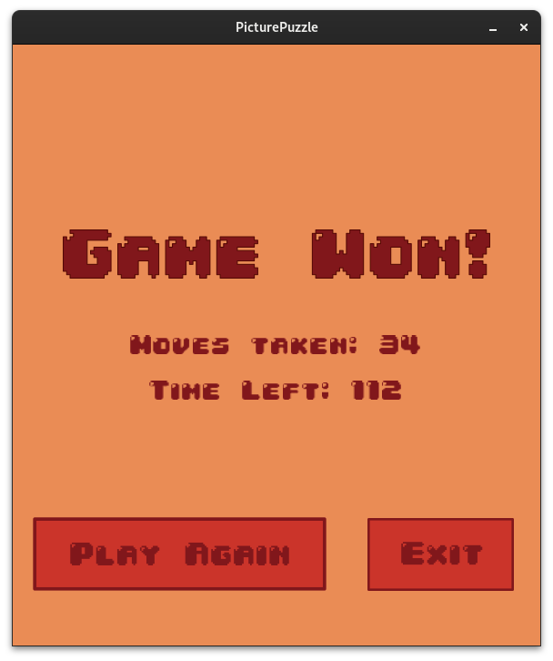
3: Gameplay
4: End Page

Slide 6

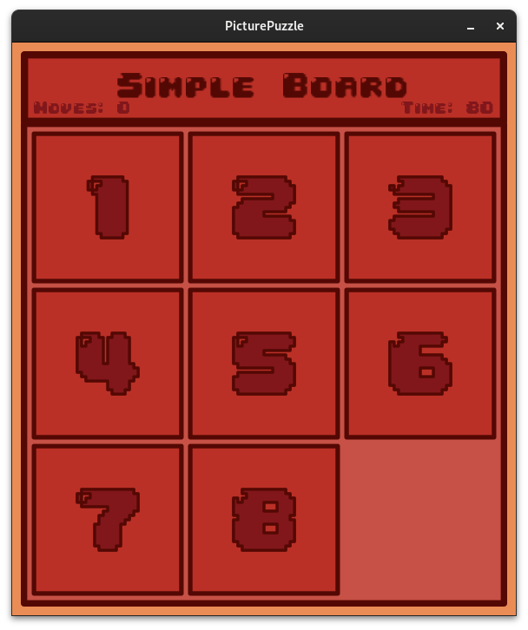
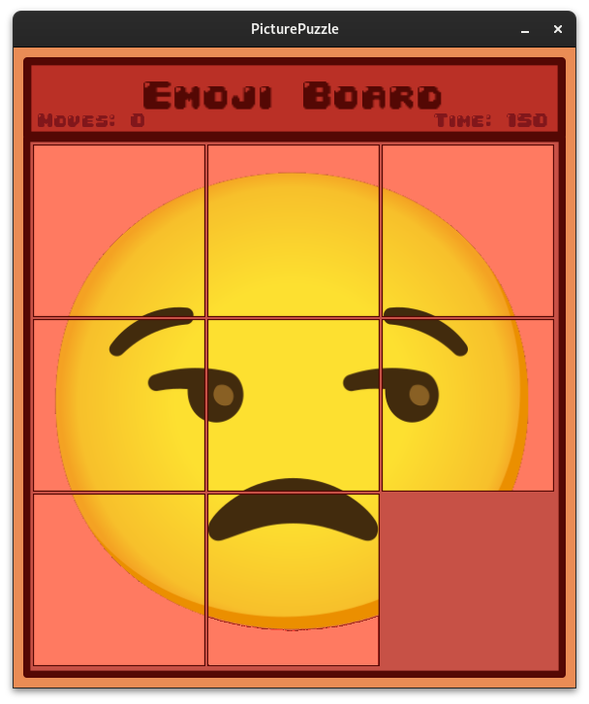
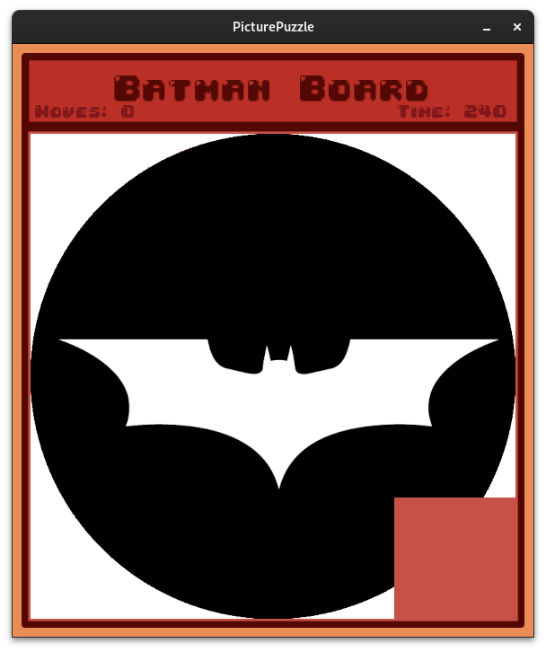
Board Types
1: Simple
2: Emoji
3: Batman

Slide 7

Technologies Used
C# as the programming language
MonoGame, the game development framework in C#
Inkscape and GIMP for asset creation and image manipulation
JetBrains Rider as the IDE

Slide 8
Future Scope
More pictures or boards with non-square grid can be added.
Ability to use any picture in the puzzle.
Adding Android support.

Slide 9
References
MonoGame Documentation – https://docs.monogame.net/
C# Documentation - https://learn.microsoft.com/en-us/dotnet/csharp/
Inkscape Tutorial - https://inkscape.org/learn/tutorials/

Slide 10
THANK YOU
Mohammad Shoaib Khan

